Slide 1
Legion Collegiate Academy

Slide 2
Mission Statement
It is the mission of Legion Collegiate Academy to serve high school students in a small, safe, family-centered setting, who seek the opportunity and challenge of a rigorous curriculum, high academic standards, and outstanding athletics while earning up to two years of college credit while in high school.

Slide 3
Executive Summary
LCA has acquired sponsorship from The Charter Institute at Erskine to provide a dual enrollment public charter high school (grades 9-12) in York County, SC with an academic, athletic and guidance program that helps interested students be college-eligible when they graduate with up to 60 hours transferable college credit. The small, rigorous, and innovative dual enrollment program is attractive and provides an alternative to the curriculum in the neighboring schools. LCA's design reflects best practices found in increasingly robust research literature on school reform. LCA assists its seniors in continuing their education by seeking admission to two- and four-year institutions, and promotes interested student athletes to obtain collegiate athletics offers.
LCA a school serving 9th through 12th grade students set to begin in the Fall of 2019.
Legion Collegiate Academy has entered into a contract with Pinnacle Charter School Management Group, LLC as its Education Management Organization (EMO).

Slide 4
Educational Management Organization
Pinnacle Charter Academies
Mike D'Angelo
President and CEO
​
Mike Miller
Chief Financial Officer
​
Erik Miller
Director of Financial Operations & Real Estate
​
Todd Helms
Director of New School Development
Director of Athletics
​
Andy Patrick
Director of Accountability
and Compliance
​
Ahna D'Angelo
Human Resources
​
Linda Miller
Marketing and Administrative Liaison
​
Laurie Jensen
Accountant
​
Jack Frost
LCA Project Coordinator
​
Anthony Hutchinson
LCA Diversity Coordinator
​
Rhonda Bayer
LCA Enrollment Coordinator

Slide 5
LCA Planning Board
Chair - Stephanie Burton (sburtonrealestate@gmail.com)
Marc Hull
(marchull44@gmail.com)​
Charles Kizer
(charleskizer1@gmail.com)
Daniel Hopper
(daniel.hopper25@gmail.com)
Joanna Harris
(joannapharris@yahoo.com)
Julie Paquette
(jpaquette@mbd.solutions)
David Stringer
(dstringer@insigniagroup.com)

Slide 6
LCA Vision
Students graduate as responsible and contributing citizens; graduate with a high school diploma and transferable dual enrollment credits up to 60 transferable hours; graduate already immersed in the culture of college and therefore be ready to engage in coursework at higher levels; be provided the necessary coaching and skill development to be successful beyond high school; develop into leaders through athletic competition and service learning; attain educational, personal, and career-awareness skills in smaller (1:25 or lower) classes, benefit from a multi-ethnic community. LCA is where parents, business partners, administrators, students, and staff work together to create an academic, physical, emotional, social, and safe environment where everyone can learn and respect one another; acquire an education through innovative techniques to enhance lifelong learning through technology and varied instructional strategies.

Slide 7
Academic Model
LCA will engage students in rigorous, in-depth academic work requiring intellectual inquiry, creativity, and critical thinking. LCA will utilize differentiated teaching strategies to include lecture, hands-on activities, and project based learning. However, LCA believes the most effective teaching strategy is to stop compartmentalizing education. All teachers will work with students to address reading, writing, and math in all their courses. Reading and writing are not solely the English department’s responsibility, just as math deficiencies are not just addressed in math classes. Teachers will work together to address deficiencies as a school and support one another in addressing issues. In addition, project-based learning during the middle years will combine standards from every discipline including public speaking which will help students understand why learning is vital to success in the 21st century.
The South Carolina Department of Education requires 120 hours of instruction to receive one high school credit. LCA students receive 165 hours of instruction per course (credit), plus needed interventions.

Slide 8
Athlete Focused
Many student-athletes struggle at the collegiate level due to the added emphasis, time, and demands of their sport and coach expectations. The LCA academic programming will eliminate much of the stress that student-athletes experience in college because of their proven collegiate track record. Too often athletes are overlooked in the scholarship process particularly when coaches fear the student-athlete may not be able to conquer the rigors of the college academic schedule.

Slide 9
LCA's Athletic Model
LCA recognizes the relationship between academics and athletics; regular exercise, skill development, and interscholastic athletic competition can play critical roles in each student’s growth. This is why LCA will host an elite sports program with a goal of 30% or more of its athletes having at least one offer to play at the collegiate level. The primary responsibility of student-athletes is their education. LCA will guide its student-athletes through the college athletics eligibility process. LCA’s academic and sports programs will nurture integrity, pride, loyalty, and character while building school spirit. In addition, students will graduate from LCA, not only academically prepared for college study, but also with college credits in place that put them closer to achieving the four-year degree while engaging in athletics in college.

Slide 10
Architect Rendering of LCA Building
Produced by Mussman Architect

Slide 11
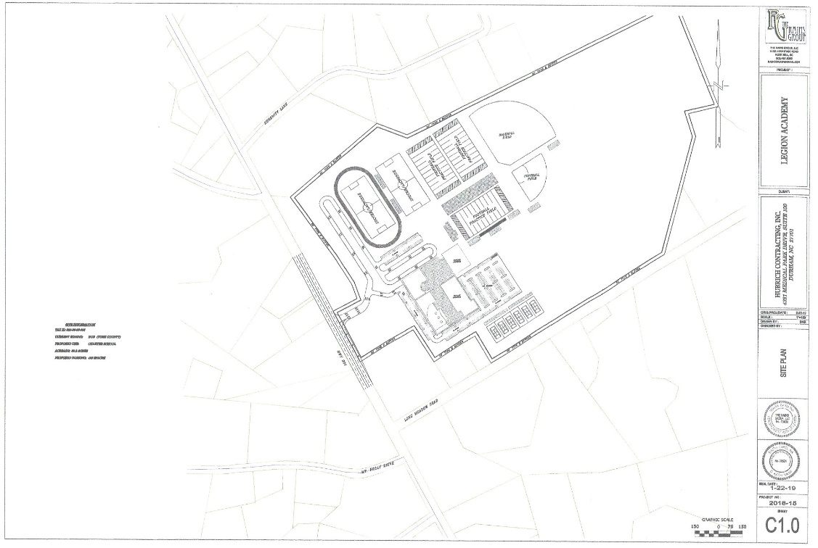
Property
A new sign designating the permanent site for Legion Collegiate Academy, a public dual enrollment charter high school, has been erected on Hwy. 901 (Mt. Holly Road).
The 83-acre site is situated about one-half mile from I-77 off exit 73 and near Nichols Store. Groundbreaking for the 47,000-square foot building is expected later this summer. The school will contain 13 classrooms, three science laboratories, a 1,500-seat gymnasium, a student center and food court, locker rooms, a weight room, administrative and coaches’ offices.

Slide 12
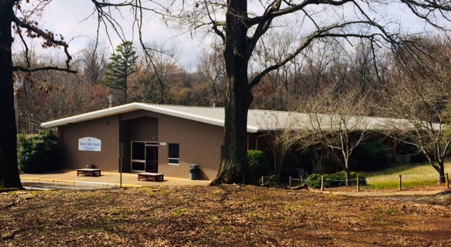
Temp Site
Legion will open the 2019-2020 school year at a temporary site on the Trinity Bible Church property at 505 University Drive. The permanent location on Mt. Holly Road will open for the 2020-2021 school year.
LCA’s new school is designed to accommodate a capacity of 600 students with 300 attending morning classes and another 300 scheduled for afternoon classes.

Slide 13
Athletic Enrollment
Numbers based on latest enrollment number: 234
FEMALE |  |  |  | MALE
NONE | 1 SPORT | 2 SPORTS | 3 SPORTS | NONE | 1 SPORT | 2 SPORTS | 3 SPORTS
15 | 48 | 30 | 18 | 14 | 48 | 42 | 10
FEMALE
VOLLEYBALL | BASKETBALL | SOFTBALL | SOCCER | LACROSSE | GOLF | X-COUNTRY
35 | 29 | 29 | 16 | 0* | 11 | 9
MALE
FOOTBALL | BASKETBALL | BASEBALL | SOCCER | LACROSSE | GOLF | X-COUNTRY
57 | 43 | 31 | 14 | 2* | 5 | 9
* - Lacrosse was mistakenly not listed on the enrollment form. The numbers are higher than what is indicated.

Slide 14
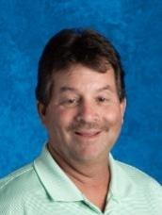
Athletic Staff Administration
AD
HEAD FOOTBALL
Strait Herron
ASST AD
ASST FOOTBALL
Bobby Carroll
STRENGTH & DEVELOPMENT
Jimmy Wallace
Guidance/NCAA Clearinghouse
Bobby Page
Click on photo to see bio

Slide 15
Athletic Coaching Staff
Click on photo to see bio
DIRECTOR OF
GOLF
Kim Case
DIRECTOR OF SOCCER
Alex Martinez
DIRECTOR OF LACROSSE
Parker Thomas
GIRLS
BASKETBALL
Asia Dozier
BOYS
BASKETBALL
Otis Wilson
VOLLEYBALL
Humberto
Guevara
SOFTBALL
Mark Cooke
BASEBALL
Devon Lowery
CROSS COUNTRY
Anthony Hutchinson

Slide 16
Conclusion
The South Carolina High School League and Legion Collegiate Academy share a “STUDENT-CENTERED” philosophy that supports a diversified group of Student-Athletes in their quest to participate in sports.
Legion Collegiate Academy is committed to growing our athletic program in a fair and ethical manner that embraces diversity, athletic ability and serves as the means to strengthen our academic achievements.
Students, parents, coaches, teachers, administration and community members support LCA’s request to become an At-Will Member of the South Carolina High School League.
Thank you for your consideration in allowing LCA to become a member. LCA’s students and school won’t let you down.

