Slide 1

FOIA & PARLIAMENTARY PROCEDURE FOR S.C. HIGH SCHOOL LEAGUE
Helen T. McFadden, PRP, JD P O Box 8, Cades, SC 29518
843-372-0717

Slide 2
Parliamentary Basics
1. NOTICE
2. QUORUM
3. MOTIONS
4. DISCUSSION OR DEBATE
5. VOTING
6. MAJORITY RULE
THE EXCEPTIONS TO MAJORITY RULE SUPPORT THE PRINCIPLES OF NOTICE, QUORUM & DEBATE
7. RECORDS OF ACTIONS TAKEN

Slide 3
Notice under FOIA
Annual notice of regularly scheduled meeting calendar
24 hour minimum notice of individual meetings to public & media
Post of notice at:
the location of meeting,
media and
NEW: Website posting now required if site is regularly maintained (Act 70 of 2015)
Staff handles these matters for you, but minutes should reflect compliance

Slide 4
Quorum under FOIA
No official action can be taken without a quorum present
Majority of meeting require a simple majority of members – 50% plus 1
Governing document may set quorum
Absent a quorum?
Adjourn
Recess and try to get a quorum
Fix the time to adjourn

Slide 5
Agenda & Amendments
Agendas are now required at all public meetings
Act 70 now restricts the ability to add items to the agenda once it is posted!
Before the meeting
items may be added so long as a new 24 hour notice is provided
If less than 24 hours – delay the meeting or wait until meeting begins
Once the Meeting has begun
an item for which action can be taken may be added with a 2/3 vote.
Final action item added must have 2/3 vote and a finding by the chair that an emergency or exigent circumstance exists.

Slide 6
Executive Sessions in FOIA
Our law specifically provides for executive session (Sec. 30-4-70) BUT ONLY to consider ONE OR MORE OF THE FOLLOWING, WHICH SHOULD BE STATED IN THE MOTION TO GO INTO EXECUTIVE SESSION:[
Discussion of employment, appointment, compensation, promotion, demotion, discipline, or release of an employee, a student, or a person regulated by a person to a public body; however, in an adversary hearing involving the employee or client, such employee or client has the right to demand that the hearing be conducted publicly. Nothing contained in this item shall prevent the public body, in its discretion, from deleting the names of the other employees or clients whose records are submitted for use at the hearing.
Discussion of negotiations incident to proposed contractual arrangements and proposed sale or purchase of property, the receipt of legal advice, settlement of legal claims, or the position of the public agency in other adversary situations involving the assertion against said agency of a claim.
Discussion regarding the development of security personnel or devices.
Investigative proceedings regarding allegations of criminal misconduct.
Discussion of matters relating to the proposed location, expansion, or the provision of services encouraging location or expansion of industries or other businesses in the area served by the public body.^{[2]}

Slide 7
ADDENDUM to FOIA
There is an additional statute protecting student records (FERPA) which is probably applicable to your deliberations from time to time and therefore deliberations which will consider student records should be in executive session.

Slide 8
RECORDS UNDER FOIA
The organization must maintain
Records of meetings - MINUTES
Records of financial transactions - AUDIT & BUDGET
Records of elections & appointments
Permanent vs. time limited retention & microfilming
Retention Schedule for governmental units
http://rm.sc.gov/generalschedules/Documents/cotxt.pdf

Slide 9
Minutes under FOIA
Section 30-4-90 requires that minutes be made for all meetings of any public body. The minimum content of these is
1) the date time and place of the meeting
2) recording of the members present and absent
3) the substance of all matters proposed, discussed or decided
4) a record of votes taken
5) any other information requested to be included by a member
Electronic retention of official recordings
The Act permits any person to record the meeting with video or audio

Slide 10
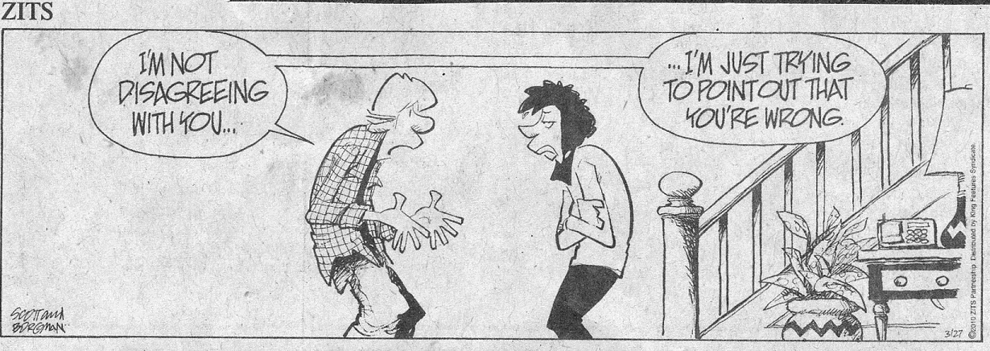

Slide 11
Debate
The Chair is responsible for controlling the flow of debate – ensure all members have the opportunity to speak
Person who raised the issue should speak first
First-in-line v. alternate viewpoint
Maintain decorum/courtesy
Should the Chair participate in debate?
Another member should preside temporarily
Ending debate
by motion of a member
Can’t interrupt a speaker
2/3 vote to cutoff debate
by the chair when debate exhausted

Slide 12
Motions
Substantive motions (main/principal)
Puts a question before the body
Only one motion at a time
Subsidiary motions
Acts upon a substantive motion
Multiple motions at the same time
Order of precedence
Incidental & Procedural motions

Slide 13
Motions: Amendments
Three types of amendments .. strike, insert, or strike and insert (to substitute is a strike and insert)
Main motion - an amendment - and an amendment to an amendment
Amendments limited to immediately pending motion and must be germane
What is a “friendly amendment: Amendments modify the previous motion”—don’t do this, either use unanimous consent or just vote on it!!!
Multiple subsidiary motions to the same main motion - Order of debate

Slide 14
I MOVE TO CHANGE THE TIME FOR REGULATION PLAY FOR MIDDLE SCHOOL SOCCER GAMES FROM 50 MINUTES TO 45 MINUTES AND TO REQUIRE ONLY A 20 MINUTE HALF TIME.
I MOVE TO REQUIRE AT OUR ANNUAL MEETING A SET ASIDE OF ONE HOUR DURING WHICH THE CLASSES OF SCHOOLS SHALL MEET AND THAT THE LEAGUE WILL PROVIDE THE SPACE WITH REFRESHMENTS FOR THIS MEETING.
I MOVE THAT STUDENT SMITH SHALL BE DETERMINED TO BE ELIGIBLE TO PLAY FOOTBALL DURING THE FALL SEMESTER AT C.E. MURRAY HIGH SCHOOL BUT THAT HE SHALL NOT BE ELIGIBLE FOR OTHER SPORTS DURING THE FALL SEMESTER.

Slide 15
Other Issues
Provisions for alternative attendance
Not acceptable for judicial hearings
A.G. opinion: Town of Tega Cay
Ability to hear and be heard
Abuse of proceedings
Personal attacks by members or the public
Removal from a meeting
SCAG: discipline is a legislative action granted to the body

Slide 16
Role of the Chair
Preside at meeting/hearings
Keep the meeting from “going off the rails” while not “controlling” the meeting
Maintain order and decorum
Extends to public and members
Rule on points and motions
Recognize speakers

Slide 17
Postponing/Reviving Matters
Postpone/carry-over:
time certain (2/3 vote)
no-limit (majority vote)
debatable, amendable, can be reconsidered
Table/lay on the table – postpones until a later time – dies if not taken from the table by the end of the meeting
can’t be reconsidered
Reconsider – reconsider an action made at the same or immediately proceeding meeting.
Motion must be made by member voting on the prevailing side of issue

Slide 18
SPECIFICS ON RECONSIDER
Under Robert, only a member on the prevailing side can make the motion to reconsider.
The motion must be made at the same meeting or before the close of the next meeting, assuming the meetings are at least quarterly.
If motion is not reached by reconsideration, it can be renewed at the next meeting or rescinded at the next meeting.

Slide 19
Voting
Generally by voice/show of hands
Passage
Majority: (simple-majority) 50% + 1
2/3 Majority: these votes should be by a show of hands and both sides: for and against should be announced in order to show the 2/3
Actions affecting rights of members: amending agenda; call the question; postpone to time certain
Tie vote – considered to have failed, retains the status quo
Does the Chair vote?

Slide 20
Quasi-Judicial Hearing
Individual application/appeal
Members sit in a judicial capacity
Constitutional due process and equal protection issues
Impartiality is essential!
Decisions are to be based on presented evidence only
Potential for appealable error
Applicant has the burden of proof
Speaks first and last
Evidence from staff

Slide 21
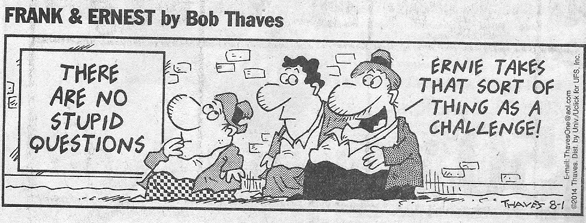
??Questions??

Slide 22
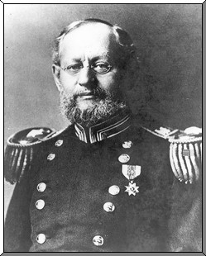
Creating Rules of Procedure
Brig. Gen. Henry M. Robert
Born in Robertville, SC
U.S. Army 1857-1901
Chief of Engineers
Buried at Arlington National Cemetery
Created Roberts Rule of Order to bring order to previously unorganized meetings!

